Slide 1

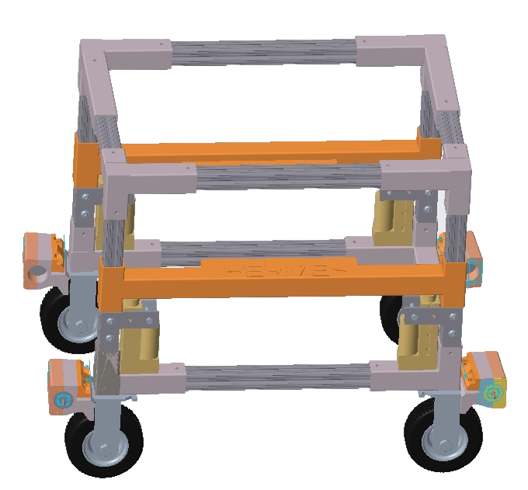
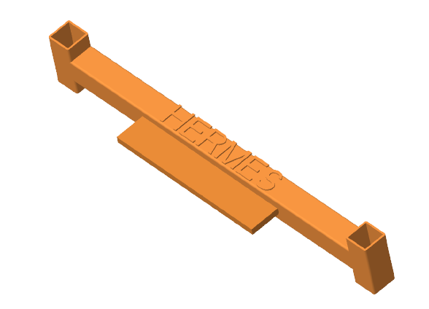



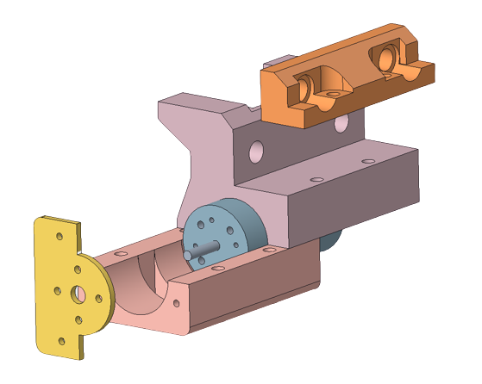






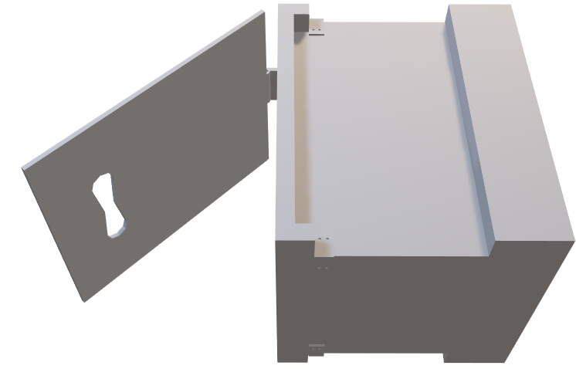
Lunar Heavy Payload Lift and Transport
Team 517 | Cameron Barnes | Cole Gutknecht | Tyler Ince-Ingram | Rafael Meza | Michael Wyrick
Sponsor: Arthur Werkheiser | Adviser: Dr. William Oates
Objective
Current State of Design
Transport heavy loads on the lunar surface between the landing site and habitation area for sustainable lunar development.
Actuating Platform
Linear Actuator Switch
Throttle
HERMES:
Heavy Equipment Rover for lunar Mobility, Expansion, and Sustainability
Key Targets
Motor Mount
Supports 308 Pounds
Verified
Steering
Weighs at Most 175 Pounds: Verified
Receiver
Traverses Ramps up to 20 degrees:
Pending Results
How it Works
Testing
Packaging Design
Device reduces size to compact into rocket cargo bay & expands out upon landing
lbs
Sand and Regolith Variable
Load Test
154
50%
Side of box conforms with platform forks to lift payload
Senses desired payload, linear actuator's allow device to lower
231
75%
Slot Packaging design locks into Place
308
100%
Linear actuators extend to lift load

